Slide 1



TTBizLink Goods Declaration

Slide 2
Contents
Background
Goods Declaration Module
Live Demo – Goods Declaration
Mobile Inspection Service
Live Demo – Mobile Inspections

Slide 3
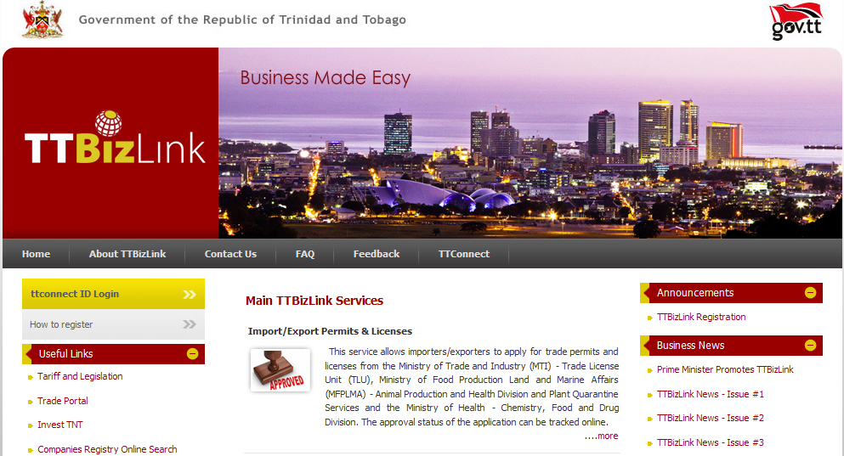
TTBizLink Modules
E-FISCAL INCENTIVES
E-IMPORT DUTY CONCESSIONS
E-COMPANY REGISTRATION
E-WORK PERMIT
E-PERMITS AND LICENCES
E-CERTIFICATE OF ORIGIN
E-NATIONAL INSURANCE BOARD REGISTRATION
E-COMPANY/PARTNERSHIP BIR &VAT REGISTRATION
E-GOODS DECLARATION
E-VENDOR REGISTRATION
E-MARITIME SERVICES
E-UTILITIES SERVICE
12 Modules
47 e-Services!
Notes:
Today we have….

Slide 4
SW Architecture
Customs Brokers
Investor/ Companies
Citizens
Companies/ Businesses
Shipping Agents
Workforce (Work Permit)
Importers/Exporters
Port Operators
CBCS (ASYCUDA)
Companies Registry,
MAGLA
Chemistry, Food and Drugs Division, MOH
exporTT LTD
&
TTCIC
Trade Licence Unit, MTI
TTBizLink Portal
Animal Production and Health Division, MALF
Plant Quarantine Service, MALF
Work Permit Division, MNS
TTBS

Slide 5
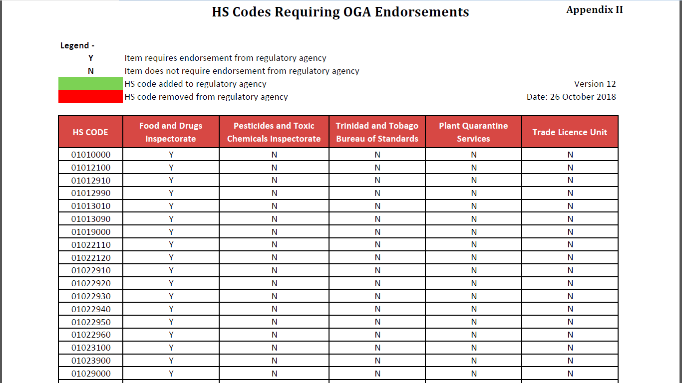

Slide 6
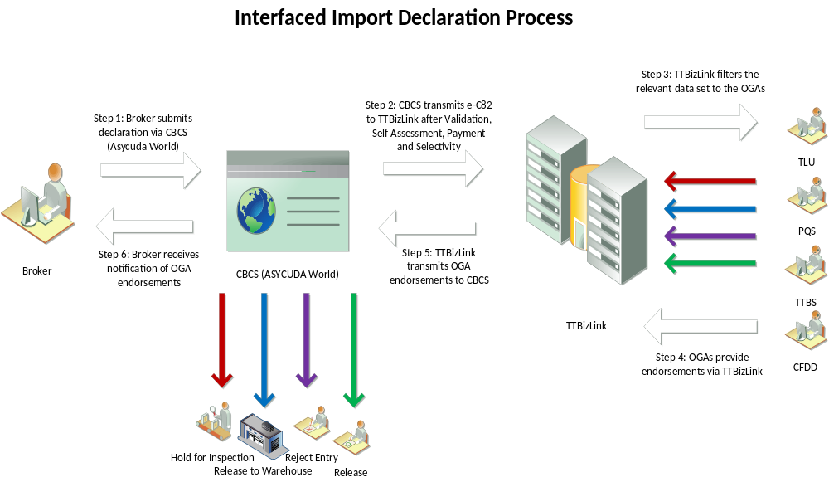

Slide 7
LIVE DEMO
GOODS DECLARATION

Slide 8
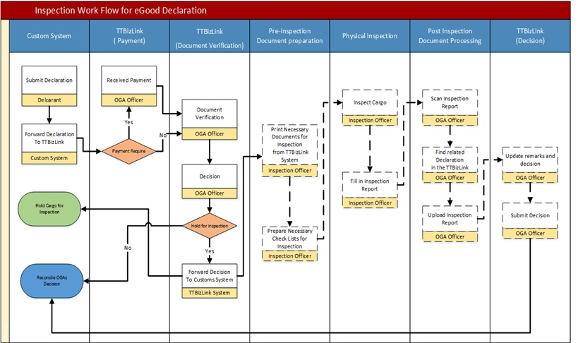
Pre Mobile Inspections

Slide 9

Mobile Inspections
Notes:
TTBizLink Mobile Inspection Service was born. Along with the backend TTBizLink enhancements, the Mobile Inspections App was developed to complete the loop in the digitization of the Import Clearance process by regulatory agencies – PQ, TTBS, CFDD

Slide 10
Mobile Inspections
Documentary Processing
Physical Inspection
Declaration
Cargo Release / Investigation
Access to accurate, pertinent information
Immediate clearance of goods after inspection
Notes:
Now, these officers can complete the entire import clearance process electronically, as the Mobile App eliminates the need for paper documents during inspections.
Mobile applications can facilitate inspectors performing inspections onsite
Enables inspectors to refer to pertinent information through a mobile interface
Facilitates the clearance of goods immediately after inspection

Slide 11
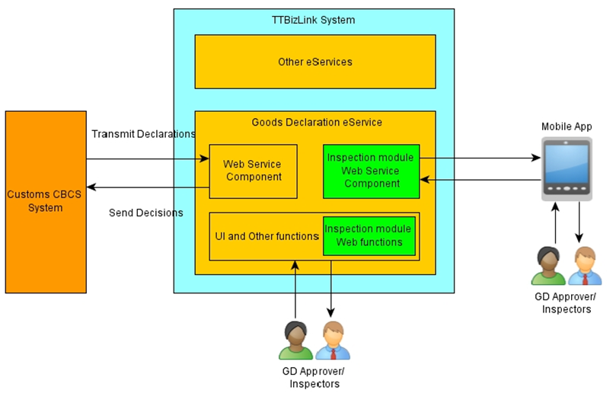
Architecture

Slide 12
Features
Checklist Management
Job Management
Mobile Inspection Application
Notes:
Effectiveness
Institutionalization and Standardization of procedures
Greater transparency and accountability
Improved record and knowledge management
Cost Savings
Eliminates paper
Efficiency
Instantaneous clearance of goods after inspection

Slide 13
LIVE DEMO
MOBILE INSPECTIONS

Slide 14
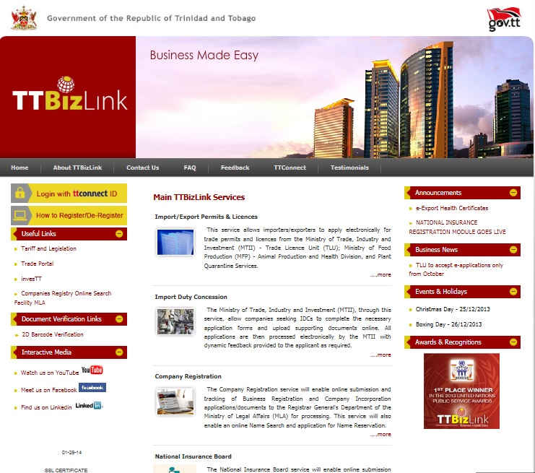
Thank you!
Christian Marquez (christian.marquez@gov.tt)
Consultant
Ministry of Trade and Industry

